Slide 1
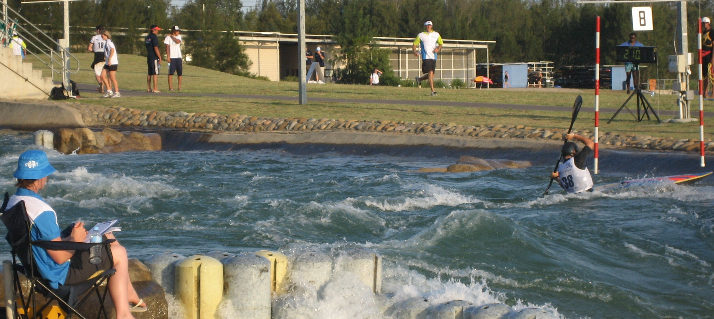
2011 ICF Canoe Slalom Coaches Conference

Slide 2
2020 Vision
11.00 | Big Picture Thinking:
 | What are the factors the world is facing over the next 4-8 years?
12.00 | The Impact of these issues on the development of a healthy sport. Identifying 4 or 5 critical questions that we need to answer.
13.00 | Lunch
14.00-16.00 | Developing a range of solutions and strategies for these questions.

Slide 3

2020 Vision
What are the factors the world is facing over the next 4-8 years?

Slide 5
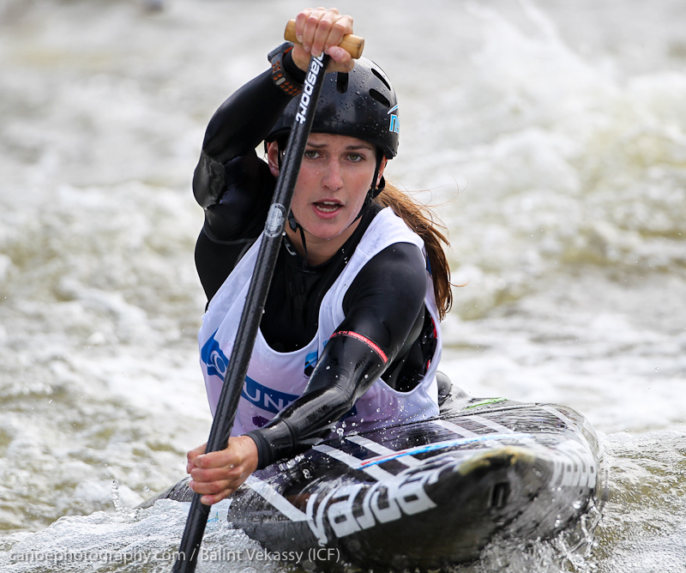
How do these issues impact on the development of a healthy sport?

Slide 6
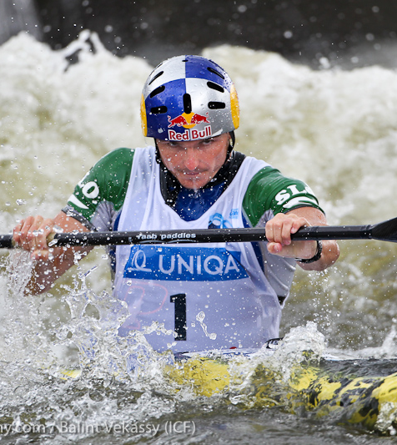
2020 Vision
What questions do we need to answer?
?
?
?
?

Slide 7
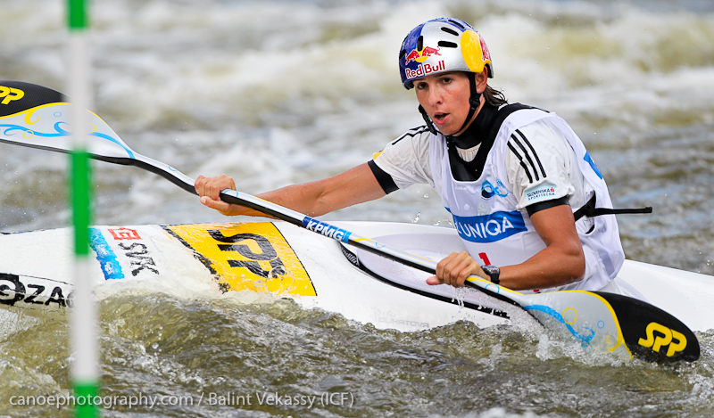
Developing a range of solutions and strategies for these questions.

Slide 8
